Slide 1
Signal Generator and Waveform Shaping Circuits Quadrature Oscillator (Sine Wave) + Astable Multivibrator (Square Wave)

Slide 2
Quadrature Oscillator
The quadrature oscillator is another type of phase-shift oscillator
Generate two signals which are 90° degree out of phase
One signal is sine wave and 2nd is cosine wave
Because there is a 90° (one fourth of 360°) phase shift therefore called quadrature oscillator
Two Opamps
Opamp 1 is working as non-inverting integrator
Opamp 2 is working as inverting integrator

Slide 3
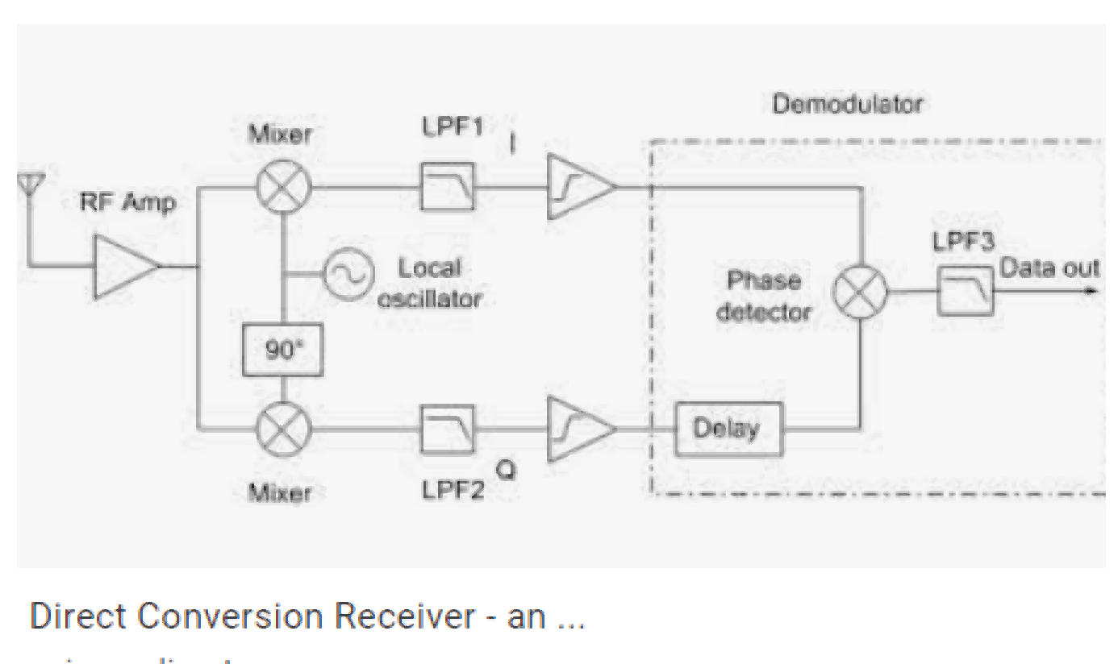
Applications of Quadrature Oscillator

Slide 4
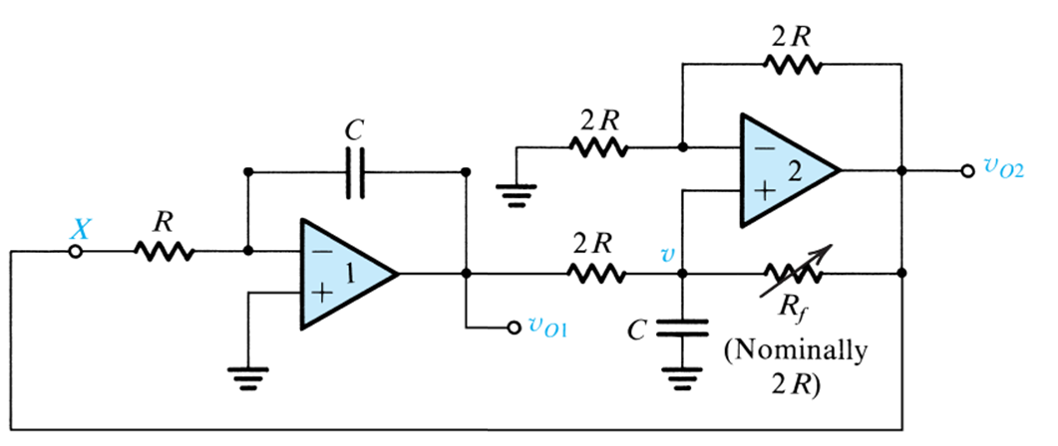
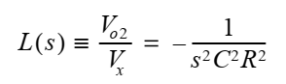
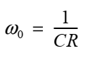

Slide 5
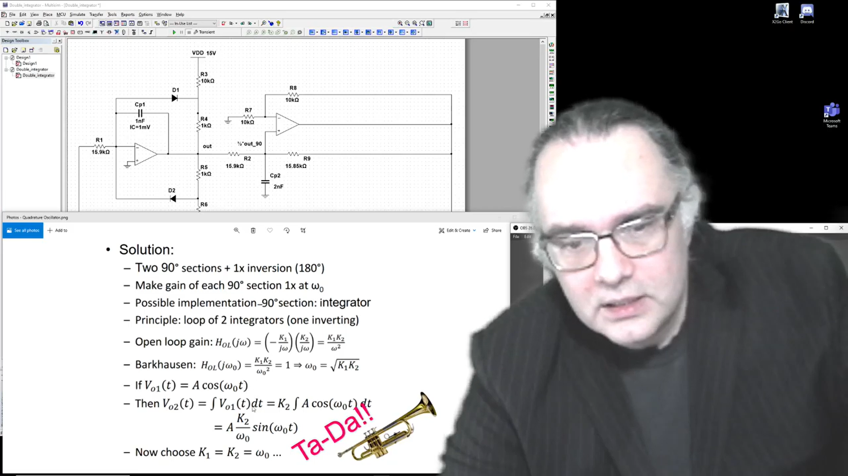
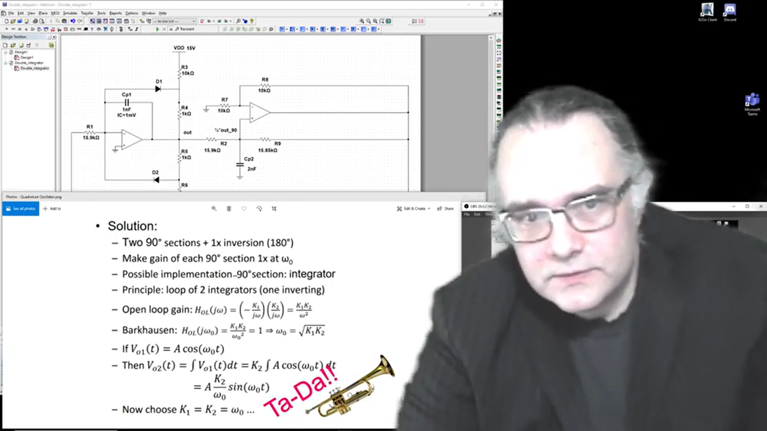
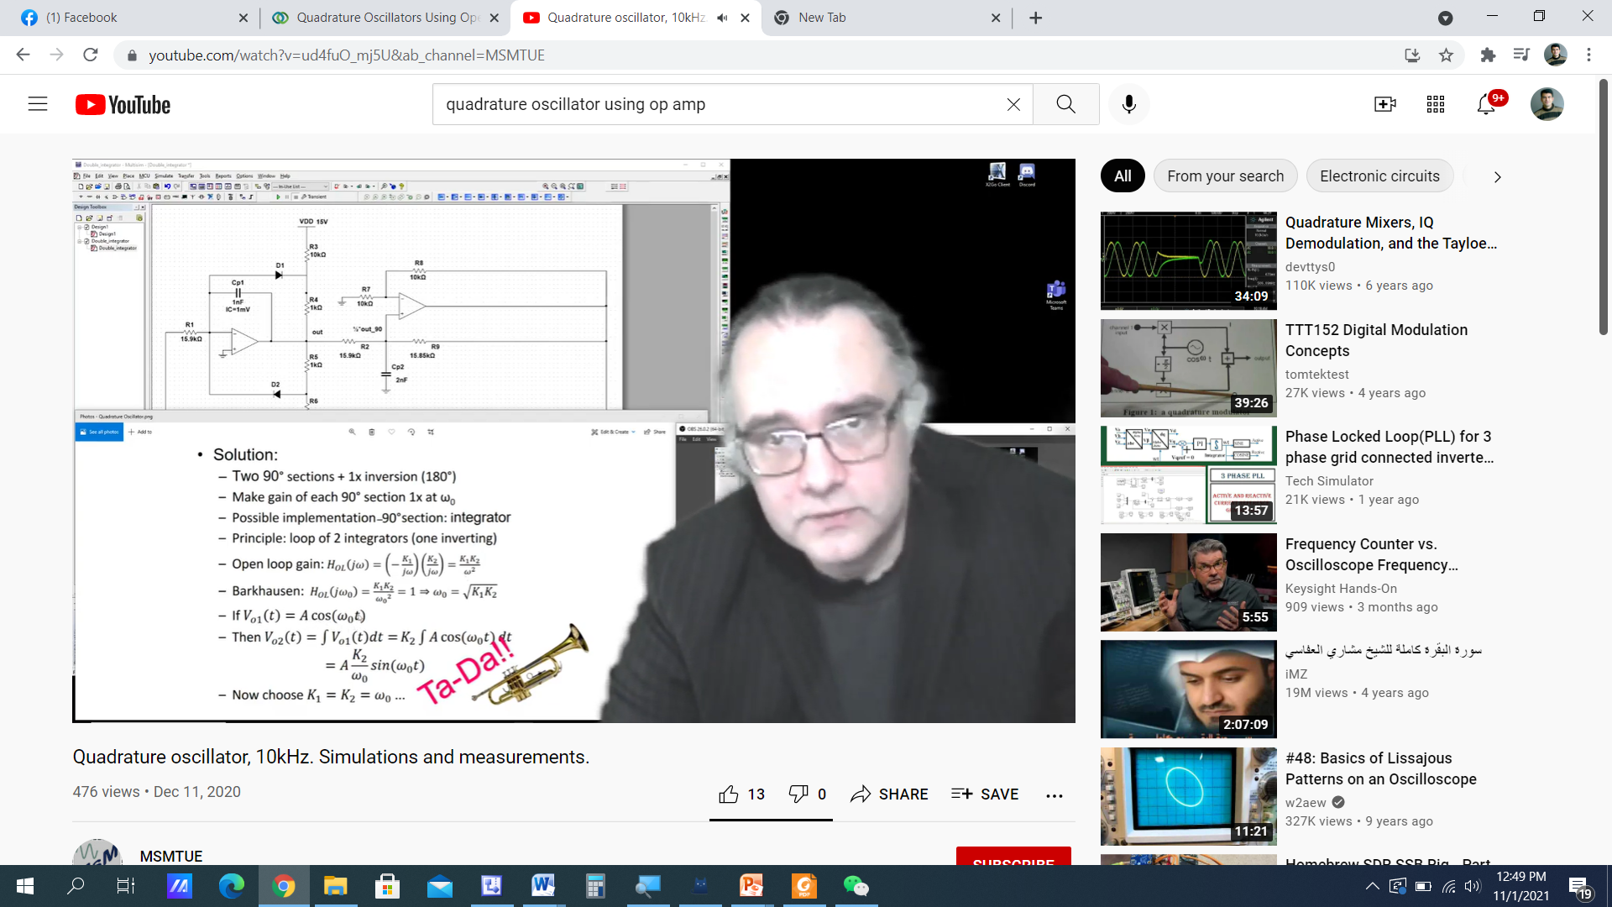
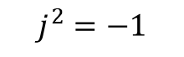
$$j^{2}=−1$$

Slide 6
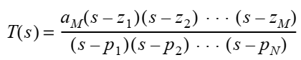
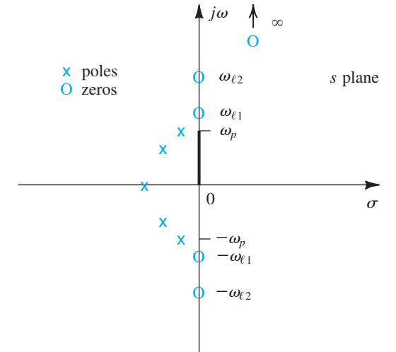
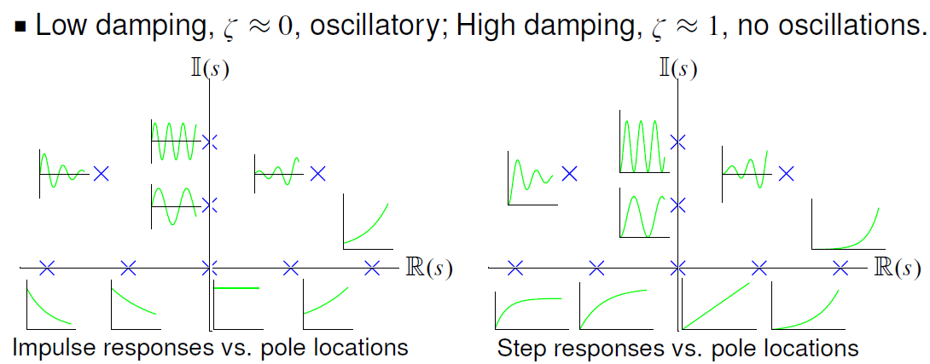
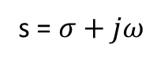
S-plane
s = $σ+jω$

Slide 7
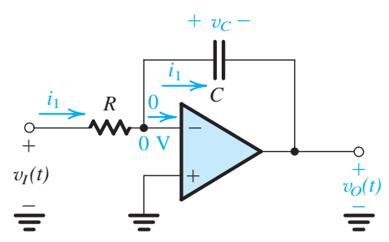
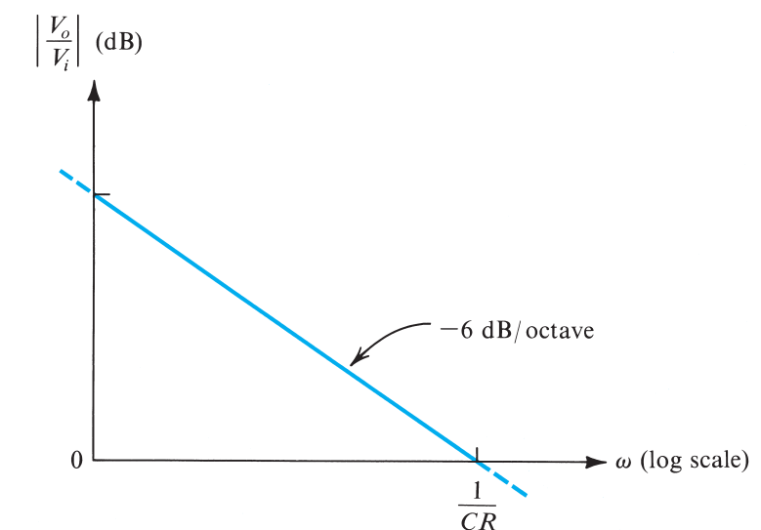
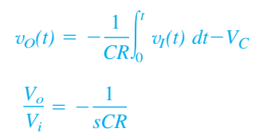
Op-Amp Integrator

Slide 8
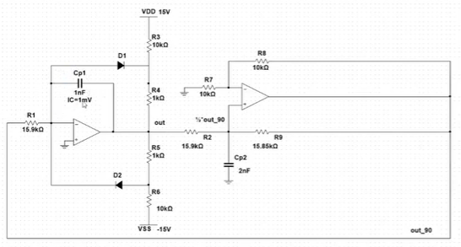

Slide 9
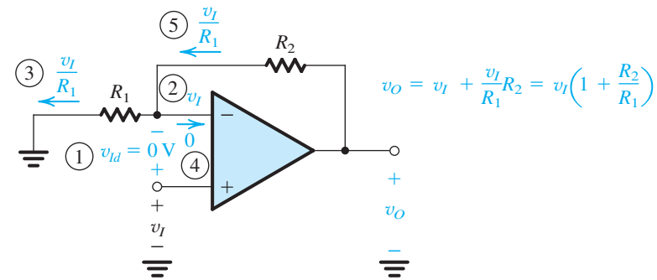
Non-Inverting Op-amp

Slide 10
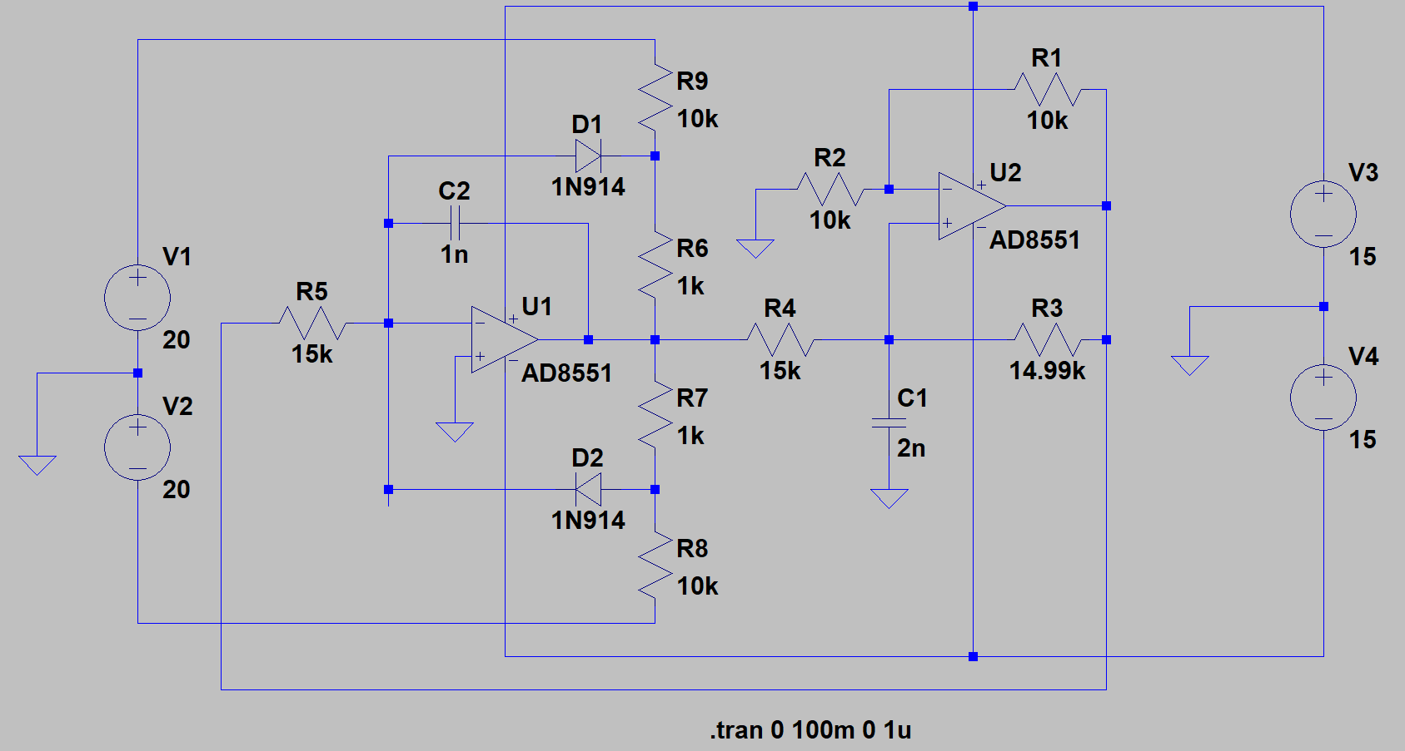
LTSpice Simulations

Slide 11
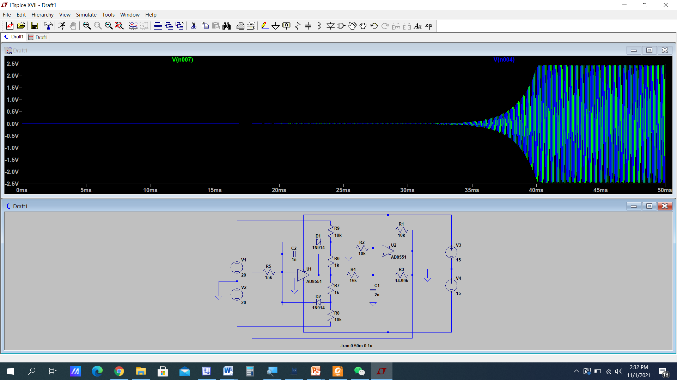
Output Waveforms

Slide 12
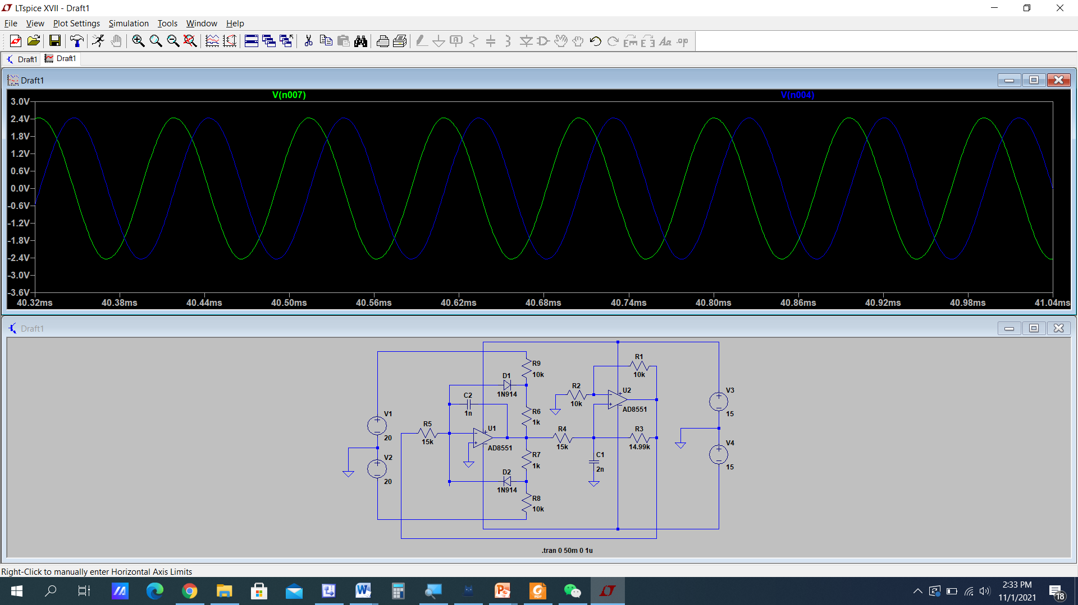
Zoom it

Slide 13
Generation of Square Waveform Using Astable Multivibrators

Slide 14
Multivibrators
There are three types of multivibrator:
Bistable multivibrator has two stable states. The circuit can remain in either stable state indefinitely. Moves to the other stable state only when appropriately triggered.
Monostable multivibrator has one stable state in which it can remain indefinitely
Astable multivibrator has no stable states

Slide 15
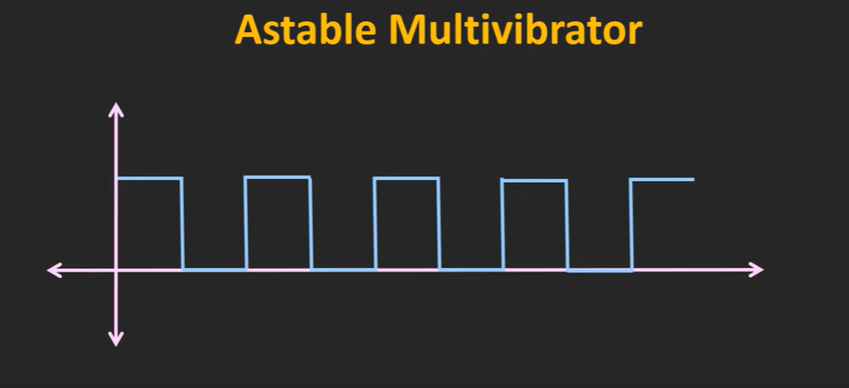

Slide 16
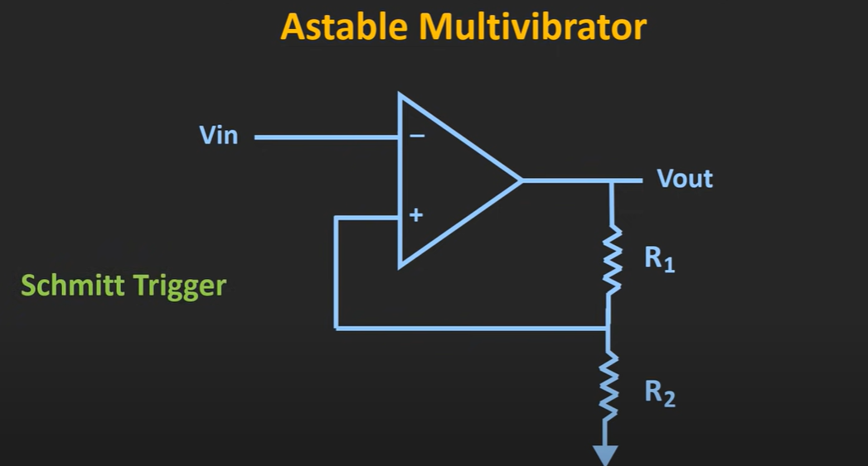
Schmitt Trigger
When the Op-amp is used in positive feedback in the following arrangement is called Schmitt Trigger

Slide 17
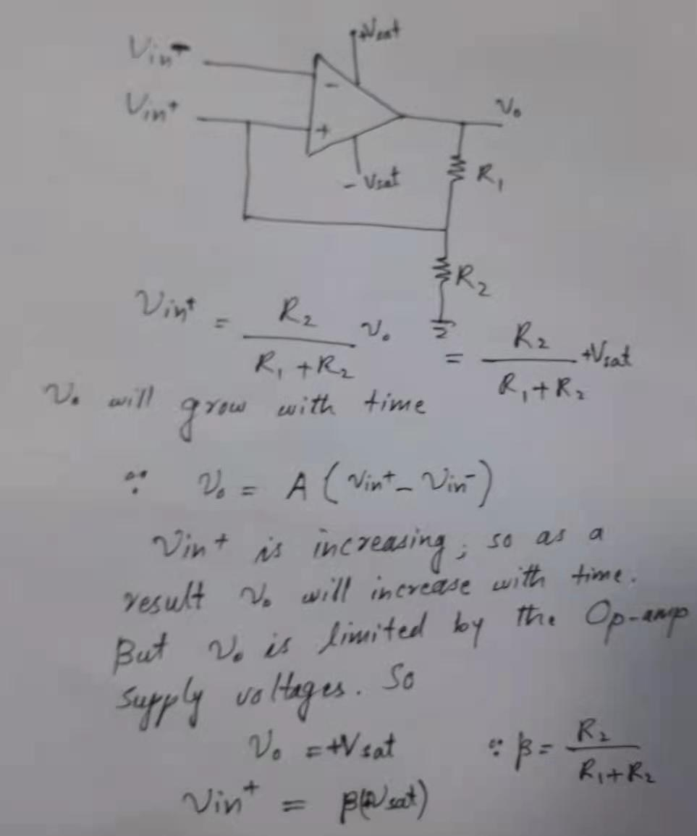

Slide 18
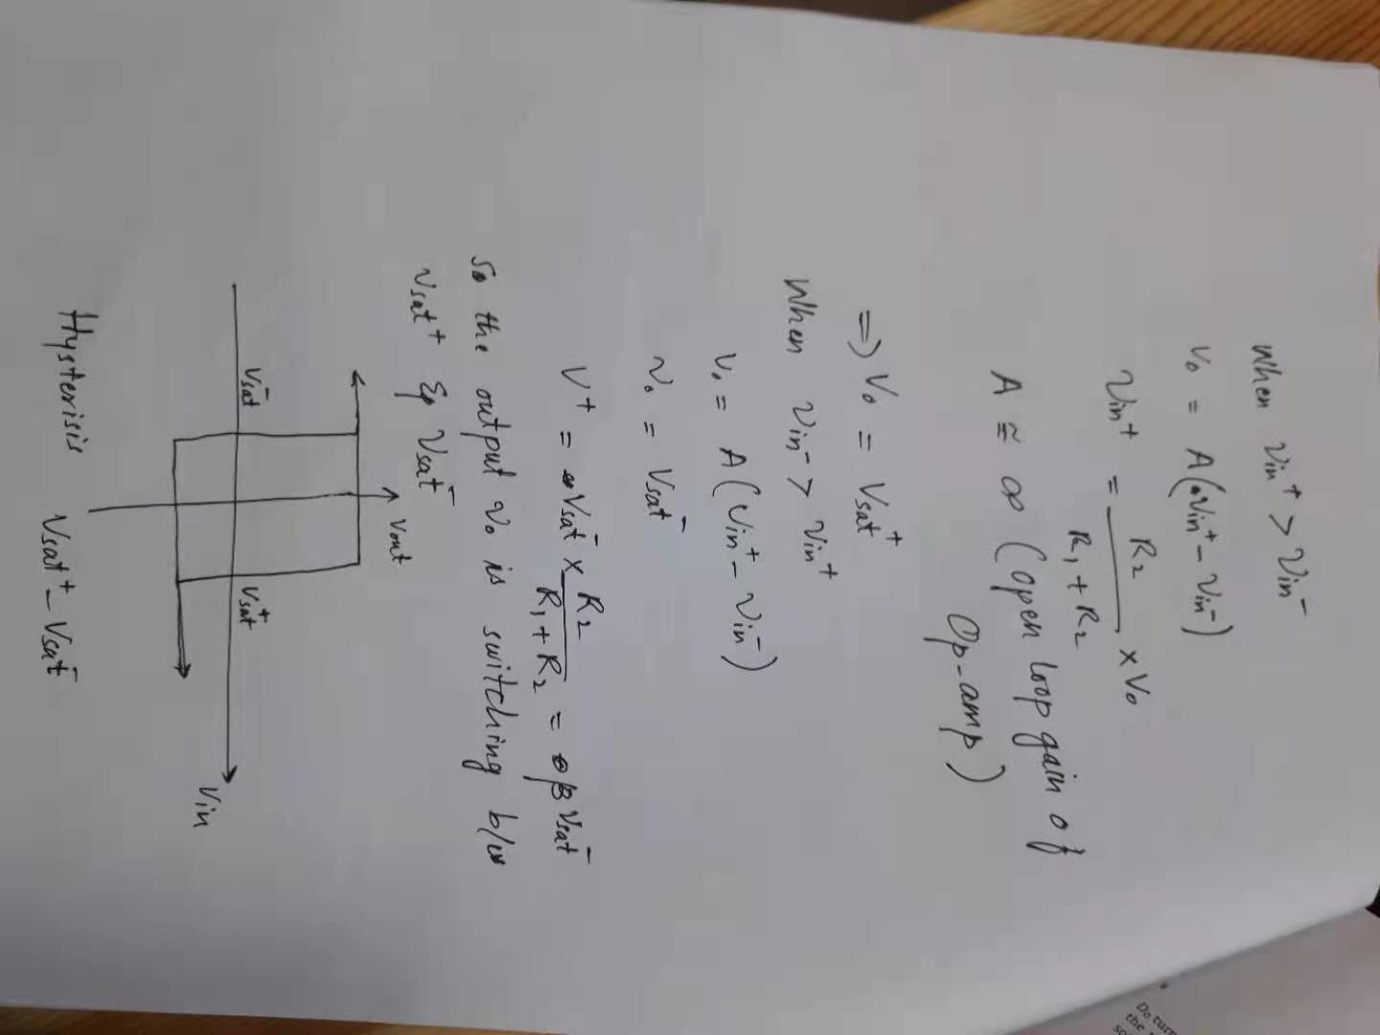

Slide 20
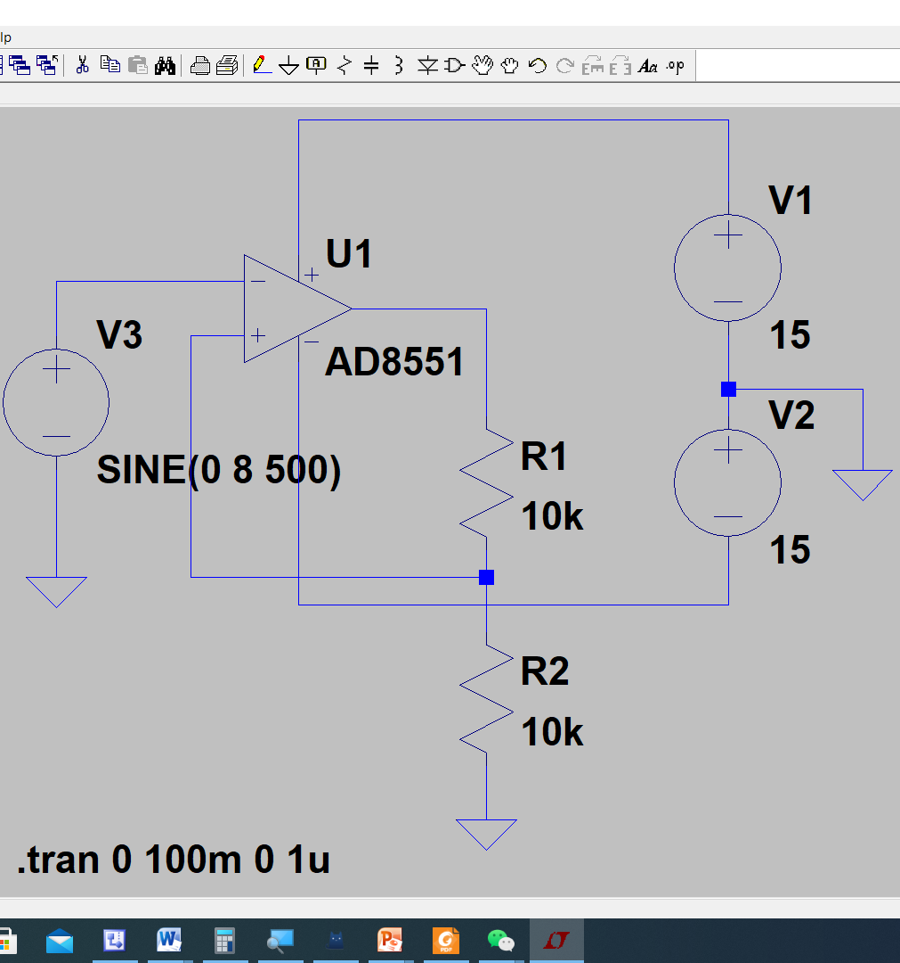

Slide 21
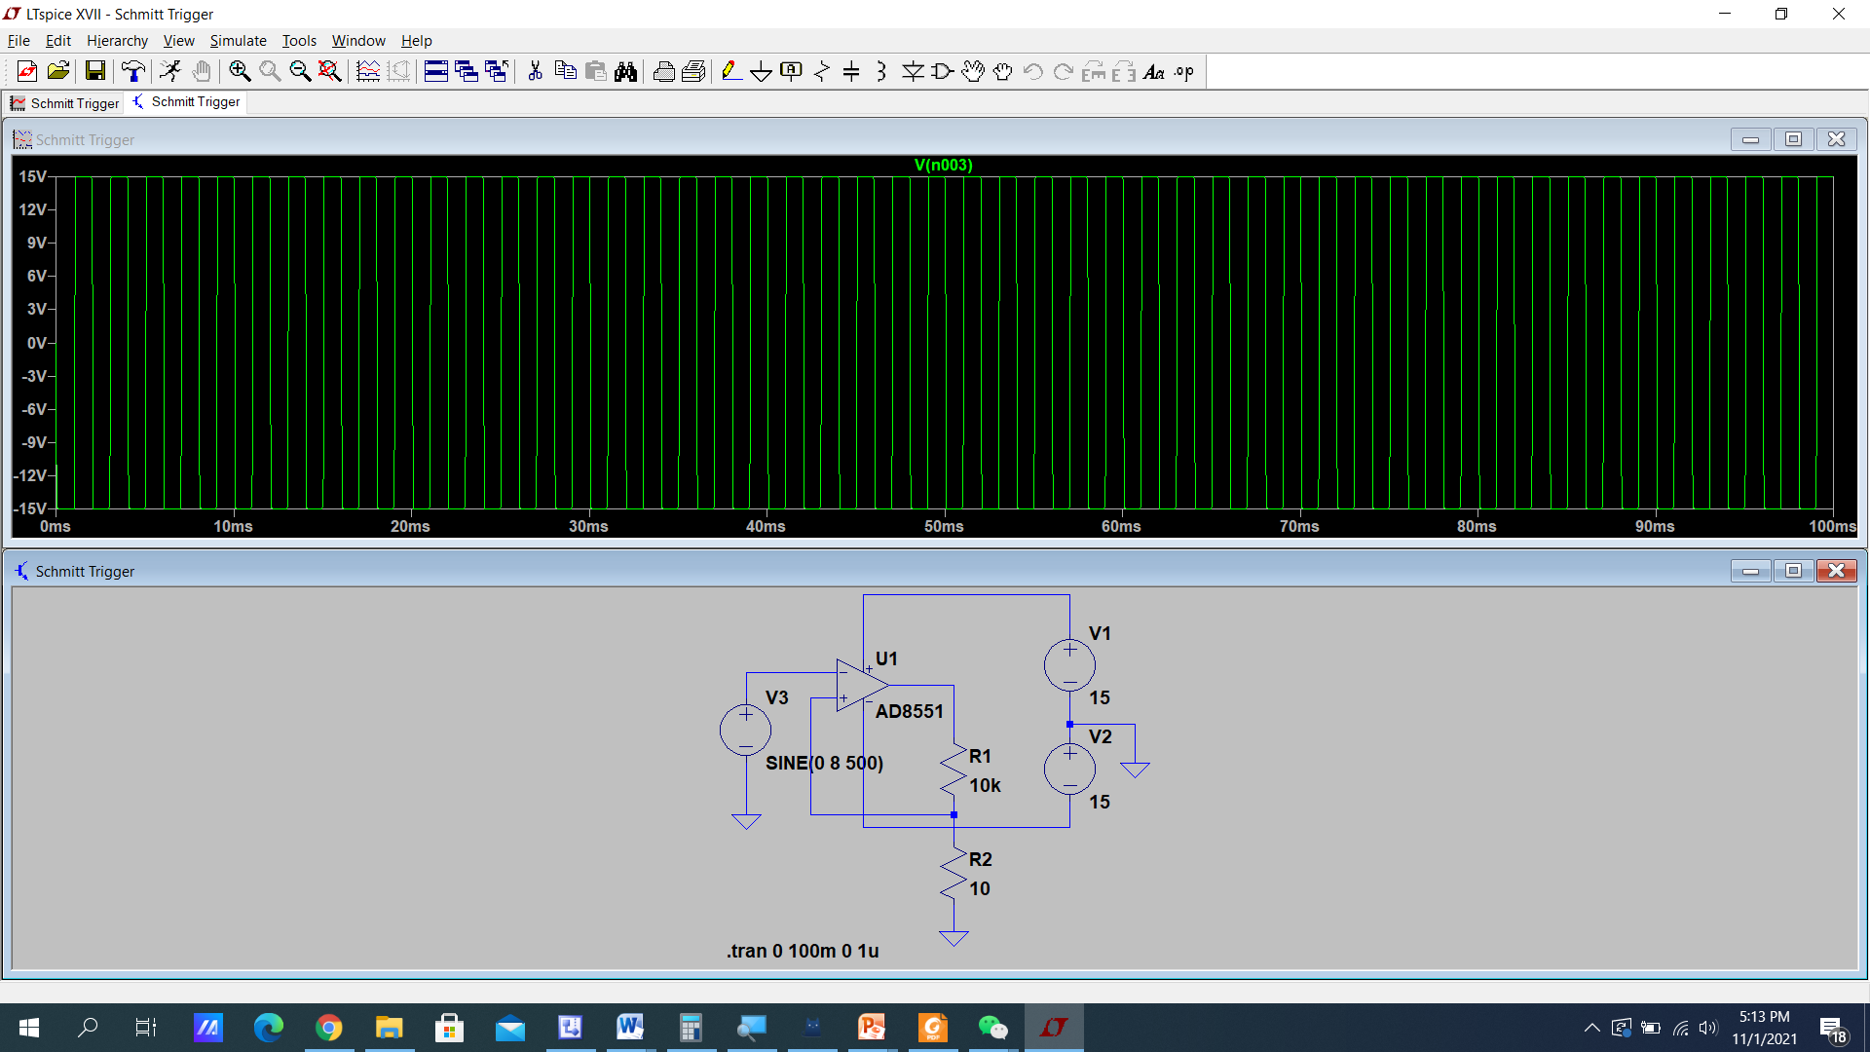

Slide 22
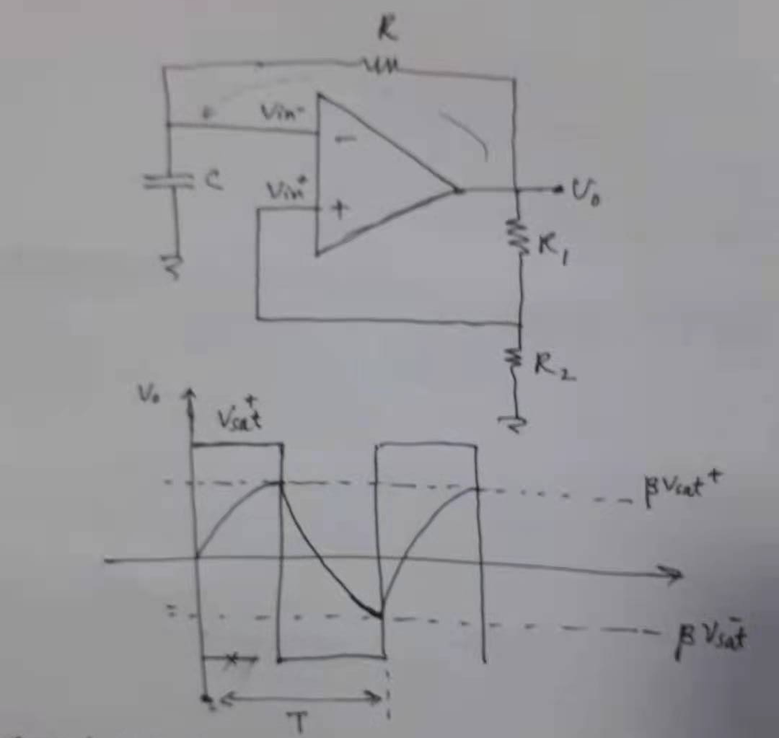
Astable Multivinrator: Square wave generator

Slide 23
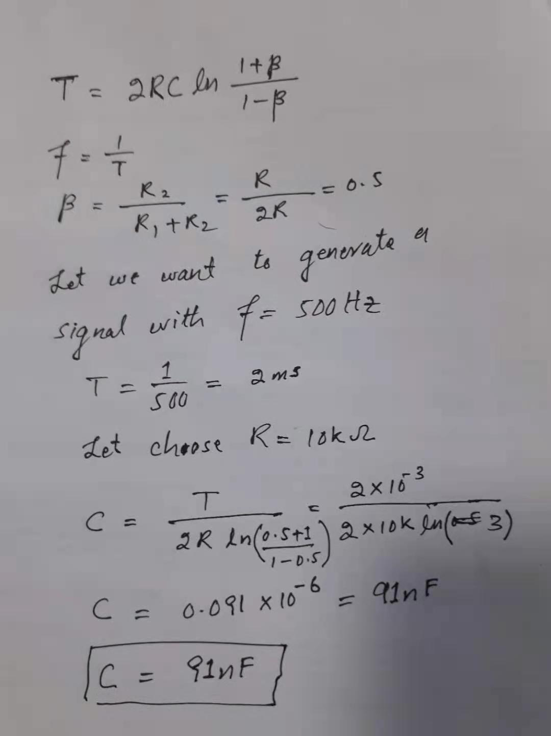

Slide 24
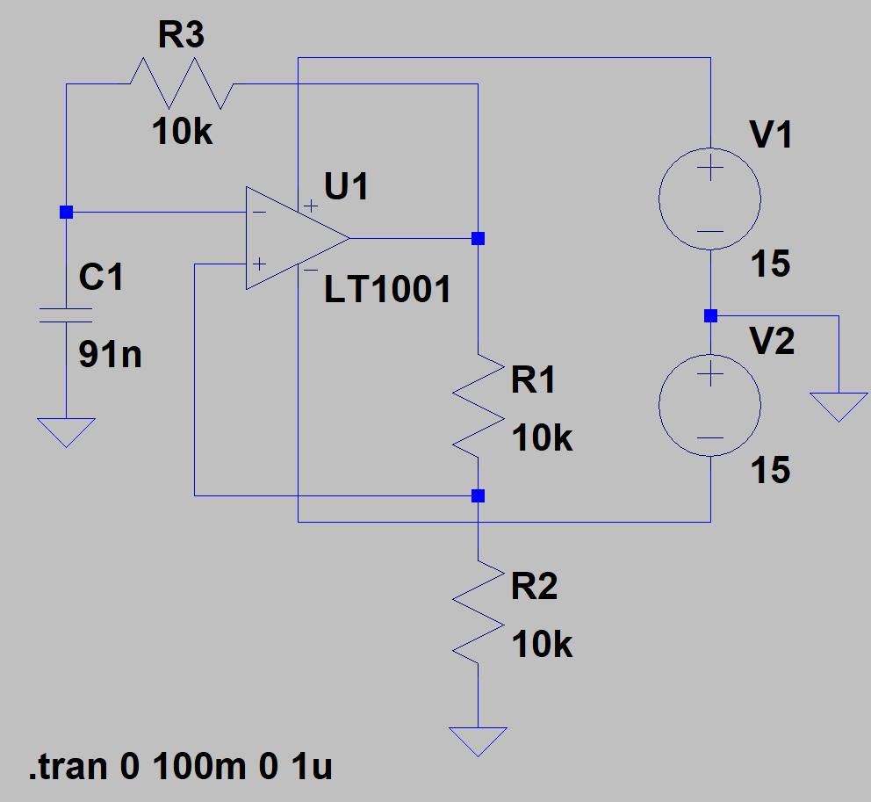

Slide 25
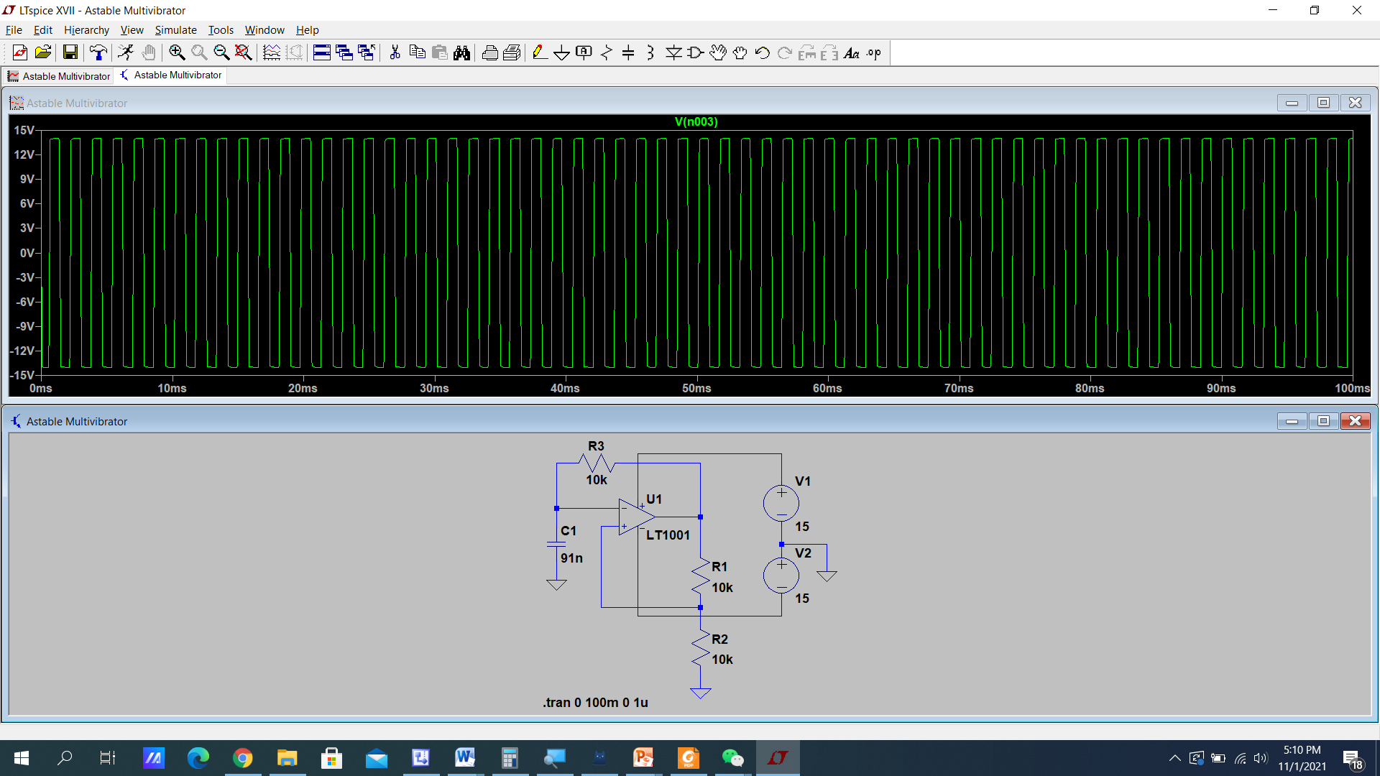

Slide 26
